Slide 1
Building apps & games for
Xbox One using UWP –
Build once and target many

Slide 2
Agenda
What is the Universal Windows Platform (UWP)
Getting to know the Tools
UWP on Xbox getting started
Windows UWP Demo
Unity Demo
MonoGame Demo
Paths to publishing
Key differences with Native

Slide 3
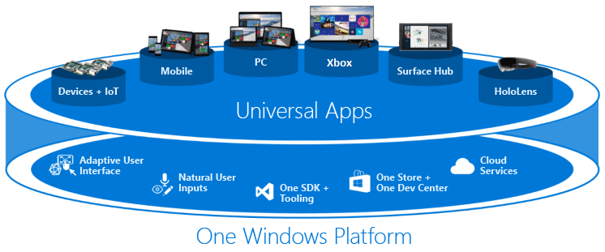
Universal Windows Platform

Slide 4
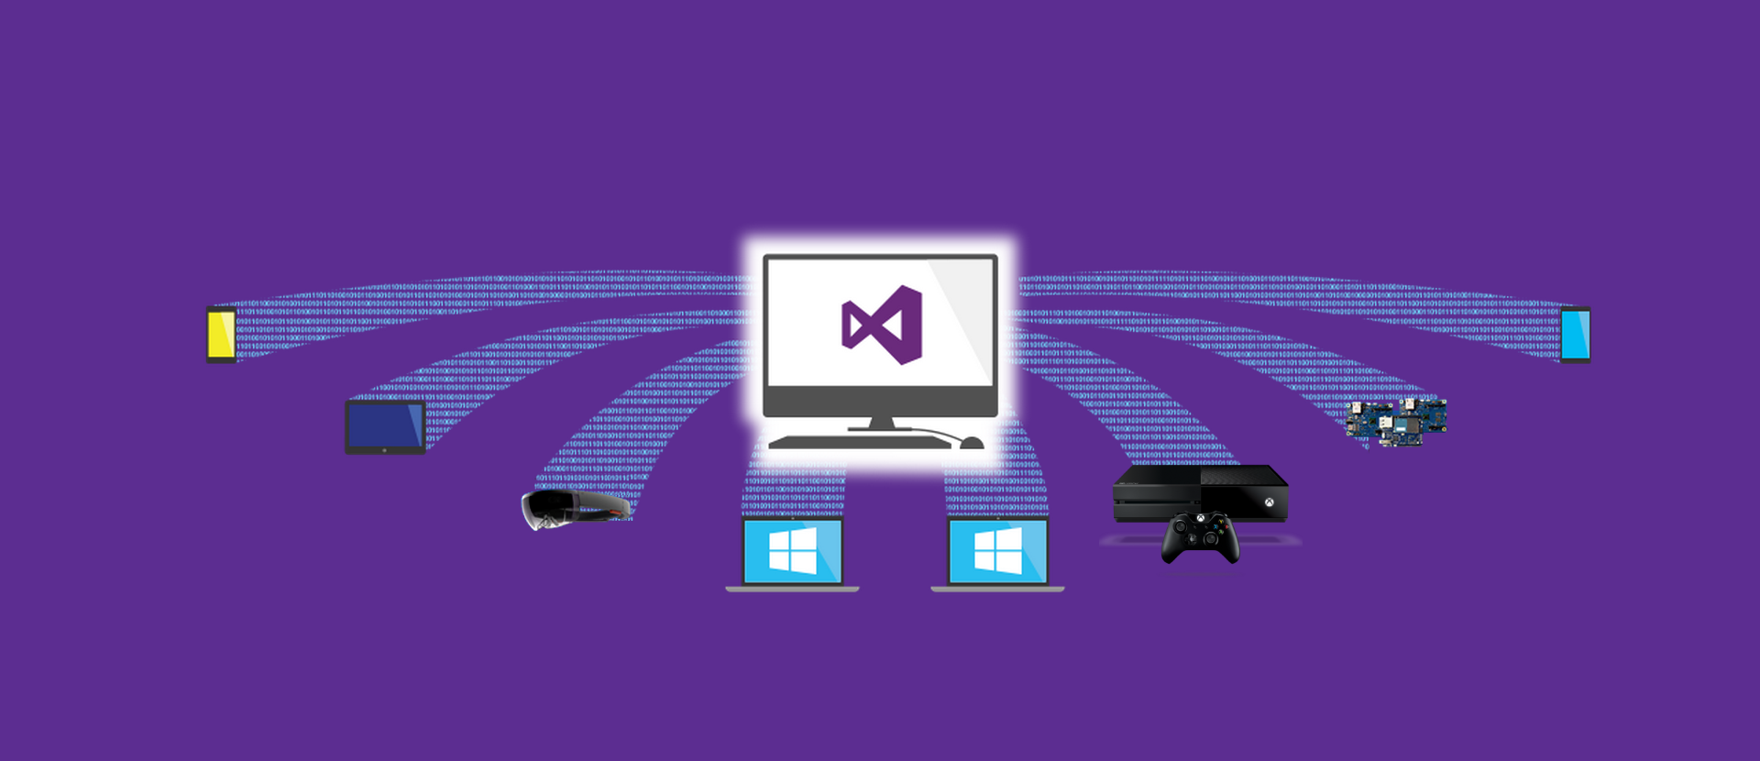
Building once, targeting many

Slide 5
Building once, targeting many, with extensions
Mobile
Tablet
HoloLens
Laptop
Desktop
Xbox
IoT
Mobile

Slide 6


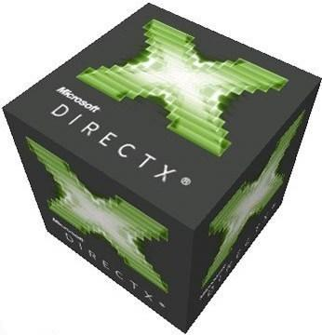




Middleware - A Growing Family

Slide 7
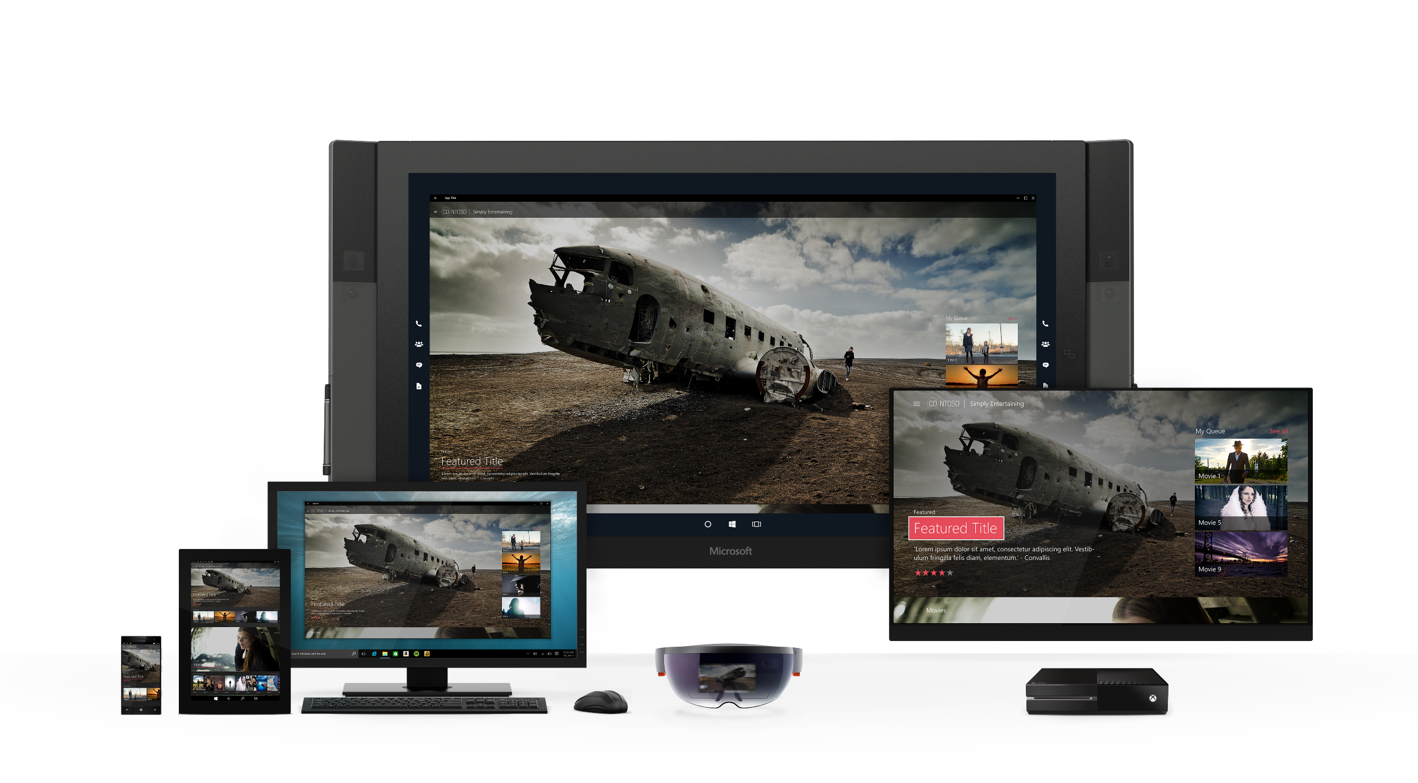
Same App tailored Experience

Slide 8
Cross-Device Platform Considerations
1’
Standard Device Resolutions
10’
360 x 640*
1024 x 640*
1366 x 768*
1920 x 1080
1920 x 1080*
Web App => 150%
XAML => 200%
* Scale Factor can vary from 100% to 300%

Slide 9
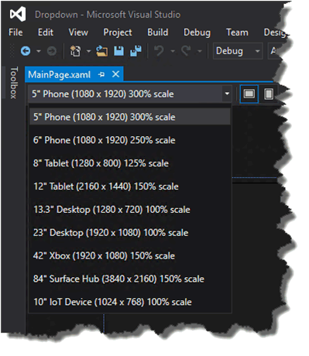
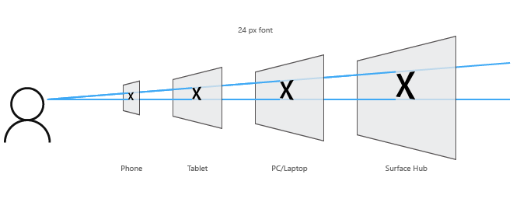
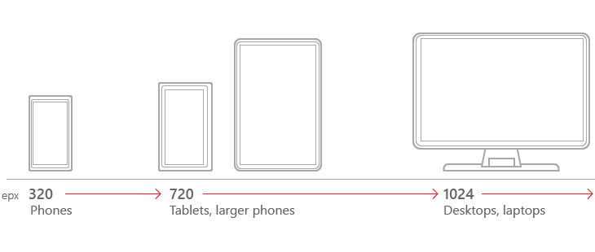
How do I achieve all this with one UWP app
Platform
Developer
| Designer
Tooling
Universal Controls + Styling
Fluid Layout Panels
Effective Pixels + Scaling
Utilize the same adaptive layout techniques from Web
Custom triggers, separate XAML, separate code as needed
Define Key Screen “Breakpoints”
Visual Studio + Blend
Simulate at Design time
Platform

Slide 10
Journey to the Universal Windows Platform
Mobilize.Net’s
Silverlight Bridge
(Porting)
Guidance
Windows Phone
Desktop Bridge
Hosted Web Apps
Other platforms
iOS Bridge
Desktop
iOS
Web
iOS

Slide 11
UWP on Xbox
Getting started with Xbox Development
What do you need?
Xbox Retail kit
Dev Mode Activation app installed (available on Xbox store)
PC (or Virtual Machine) running Windows 10
Visual Studio Community 2015 (or higher)
Windows UWP SDK
Tool / framework / engine of your choice
Free time

Slide 12
Spinning up your development environment

Slide 13
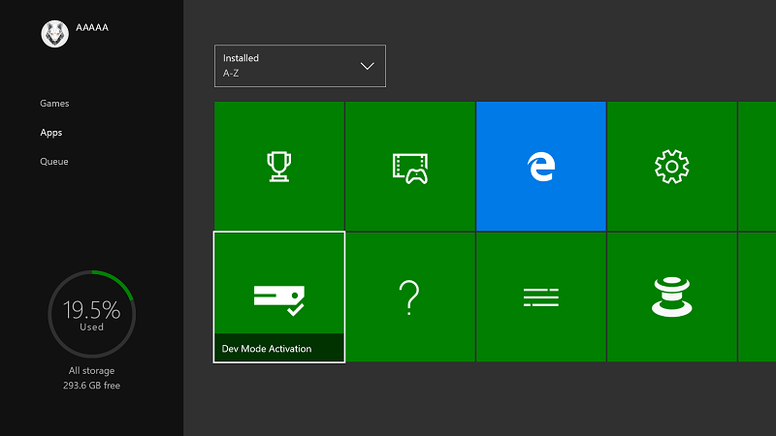
Install the Dev Mode Activation app

Slide 14
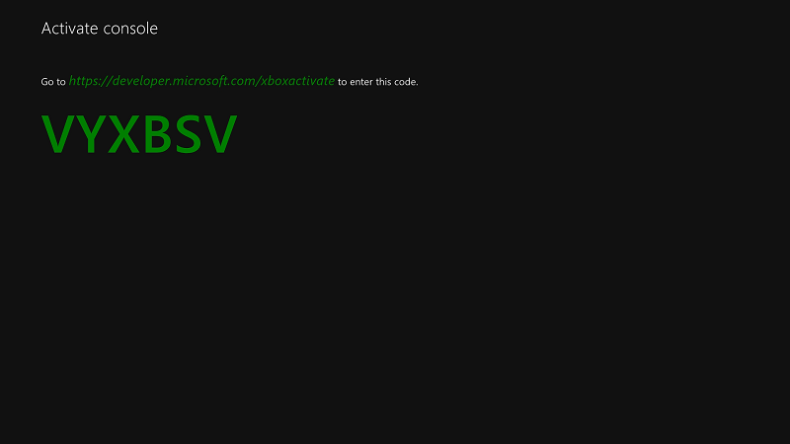
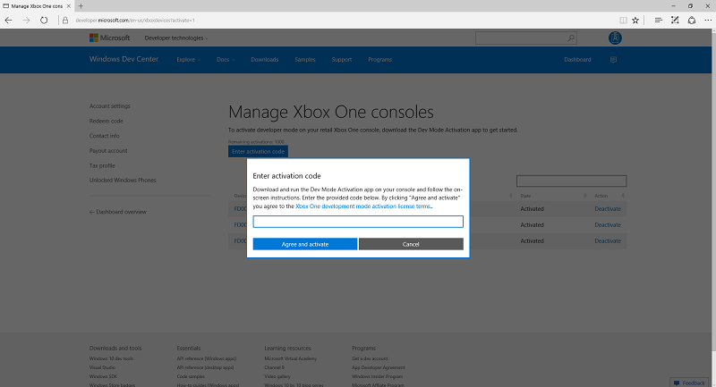
Activate on first run

Slide 15
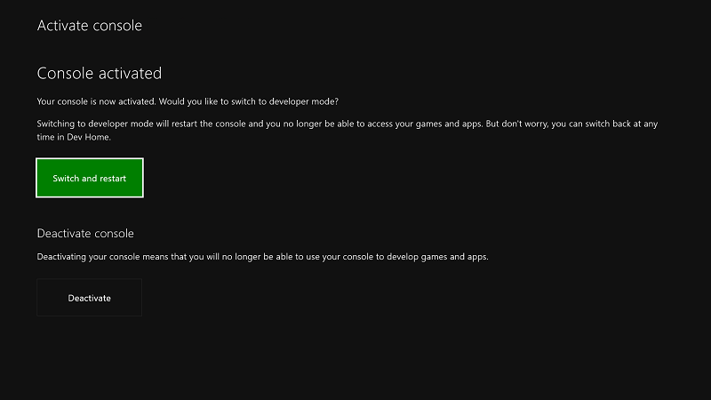
Switch and Restart

Slide 16
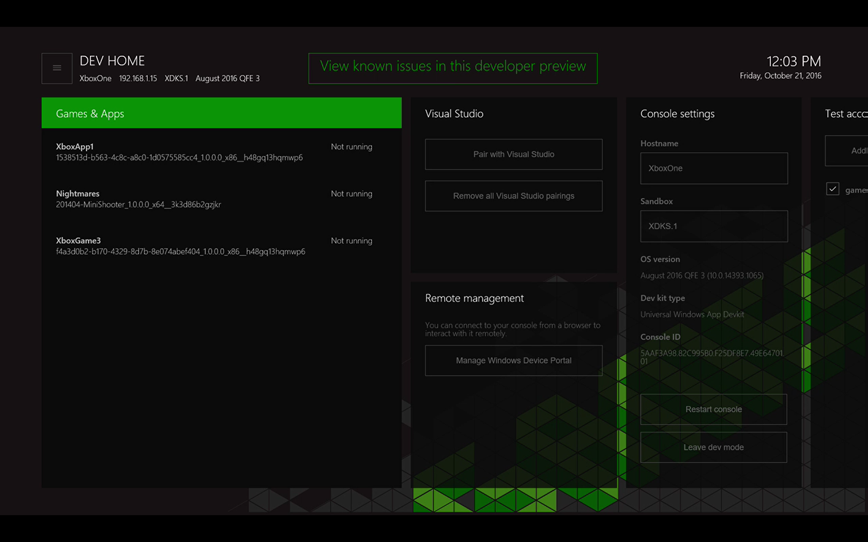
Xbox Developer app
Tool

Slide 17
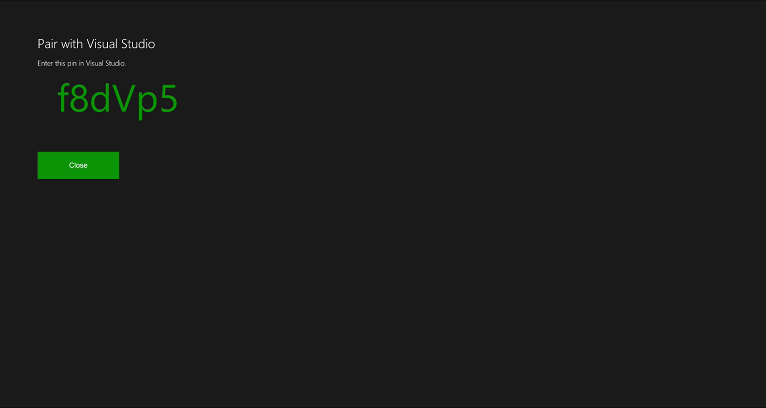
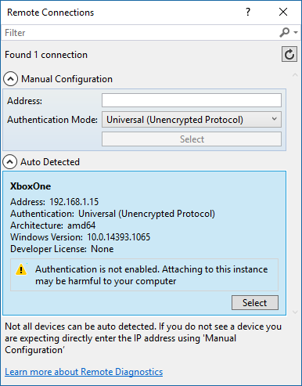
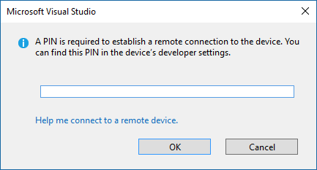
Visual Studio Remote Deploy

Slide 18
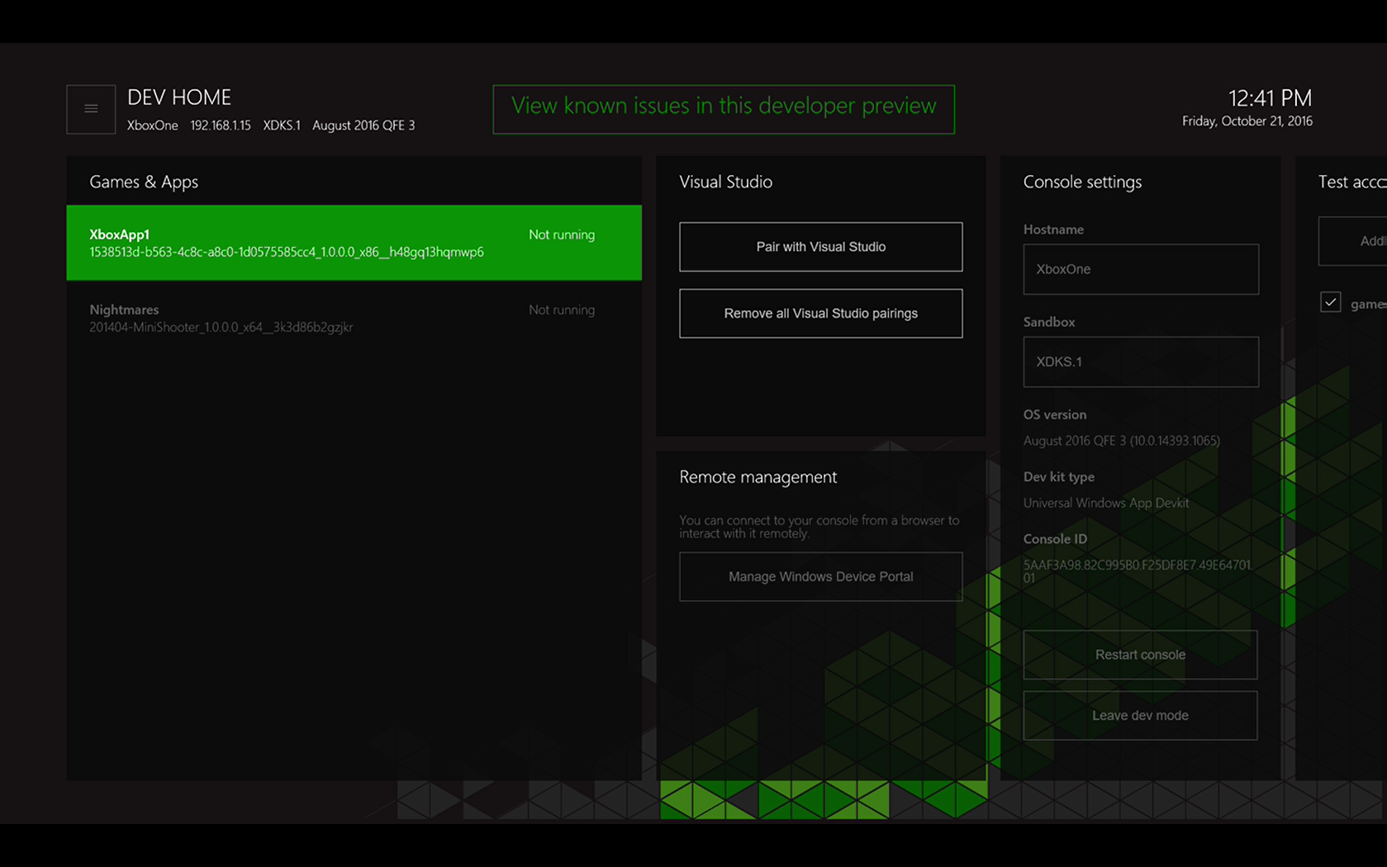
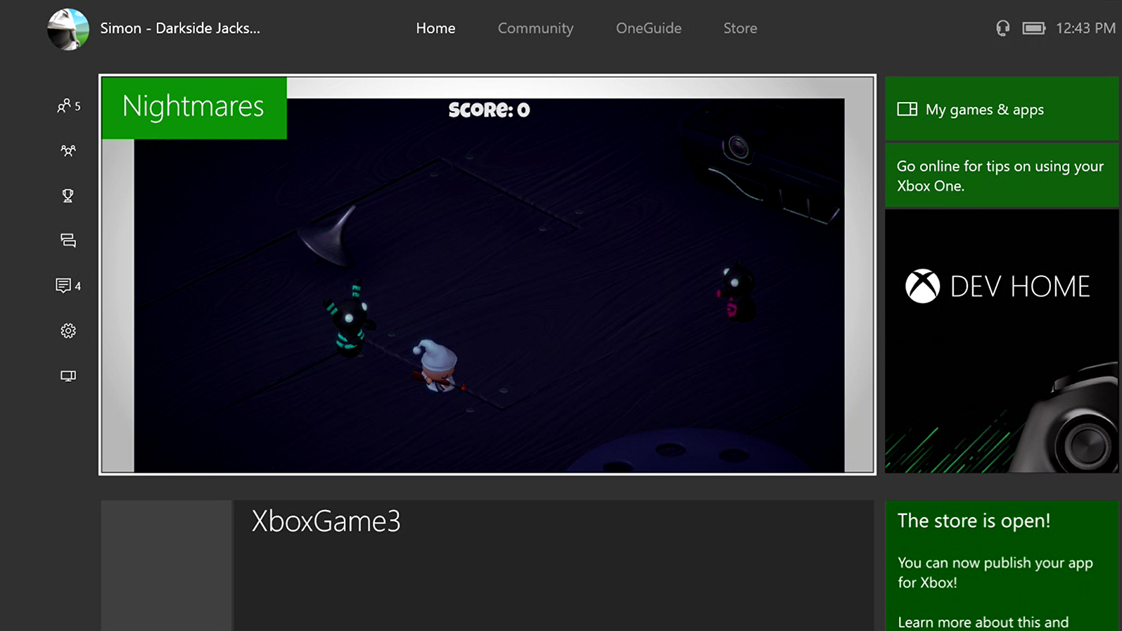
Deployed and running
Tool

Slide 19
Spinning up your development environment
Install Dev APP
Activate
Restart
Launch Dev App
Tools IP
Connect VS
Deploy
Total Start-up time – 5 Minutes

Slide 20
Demos

Slide 21
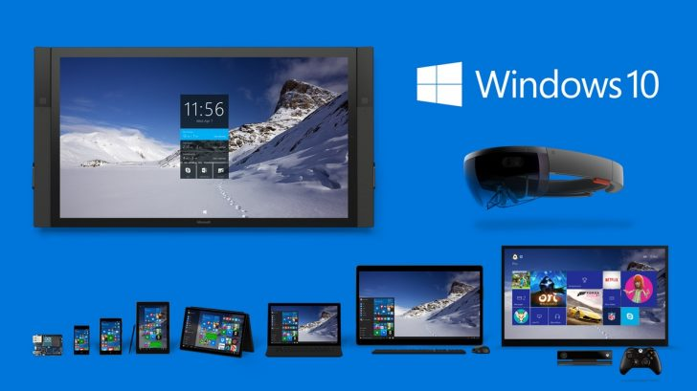
Windows UWP Demo

Slide 22


MonoGame Demo

Slide 23

Unity Demo

Slide 24
Getting your game on the Store

Slide 25
What next?
Publishing requires sign up to ID@Xbox
Focus on Windows 10 first
Apply for Xbox later
Presence is everything

Slide 26
Key differences between UWP & Native
UWP
Works on all Xbox One’s
Shorter dev cycle
Easier test and deployment
More targets
Some memory constraints
Native
Requires Dev kit
Full resource access
C++ required for tools
Xbox Only
Tougher certification Req’s

Slide 27
Get Publishing!

Slide 28
Resources
https://msdn.microsoft.com/en-us/windows/uwp/xbox-apps/index
http://www.xbox.com/id http://imagine.Microsoft.com https://developer.microsoft.com/en-us/windows/games

Slide 29
Questions?

